Slide 1

TW-project: Mighty Text Adventure: One strange evening
variables
While-Loop
While-Loop
Intro
Intro screen
Choose difficulty level
Game play
“quit”
invalid input
repeated input
correct input
wrong input
Game Win
Game Over
functions
Friday, April 14th 2023
Slide <number>
Zinaida Jusufovic
Martin Egert
Thomas Sicay

Slide 2
Wochenüberblick
variables
While-Loop
While-Loop
Intro
Intro screen
Choose difficulty level
Game play
“quit”
invalid input
repeated input
correct input
wrong input
Game Win
Game Over
functions
Friday, April 14th 2023
Slide <number>
Zinaida Jusufovic
Martin Egert
Thomas Sicay

Slide 3
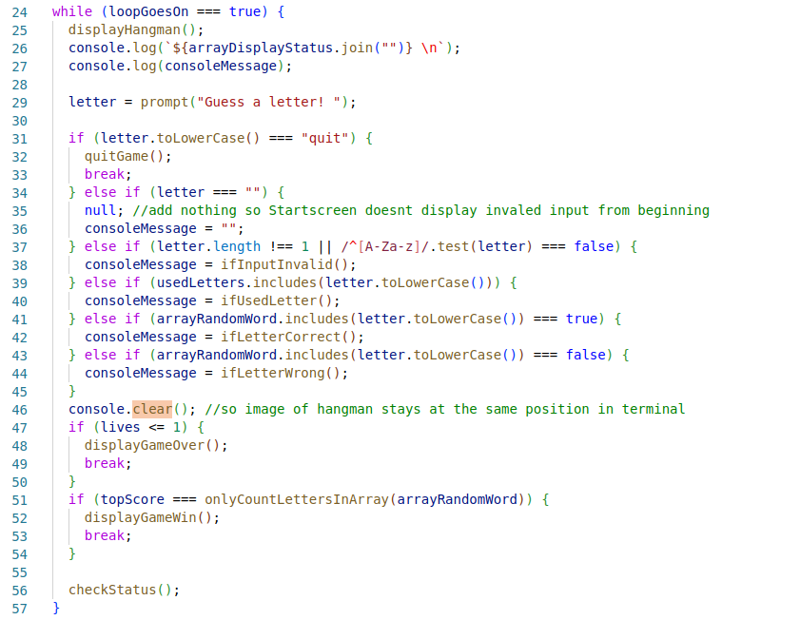
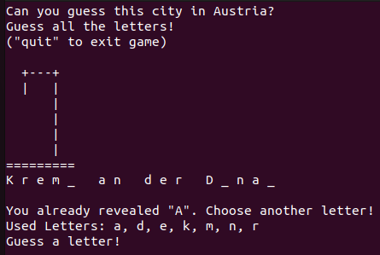
Projektstruktur
Friday, April 14th 2023
Slide <number>
Zinaida Jusufovic
Martin Egert
Thomas Sicay

Slide 4
Entscheidungsbaum
variables
While-Loop
While-Loop
Intro
Intro screen
Choose difficulty level
Game play
“quit”
invalid input
repeated input
correct input
wrong input
Game Win
Game Over
functions
Friday, April 14th 2023
Slide <number>
Zinaida Jusufovic
Martin Egert
Thomas Sicay

Slide 5
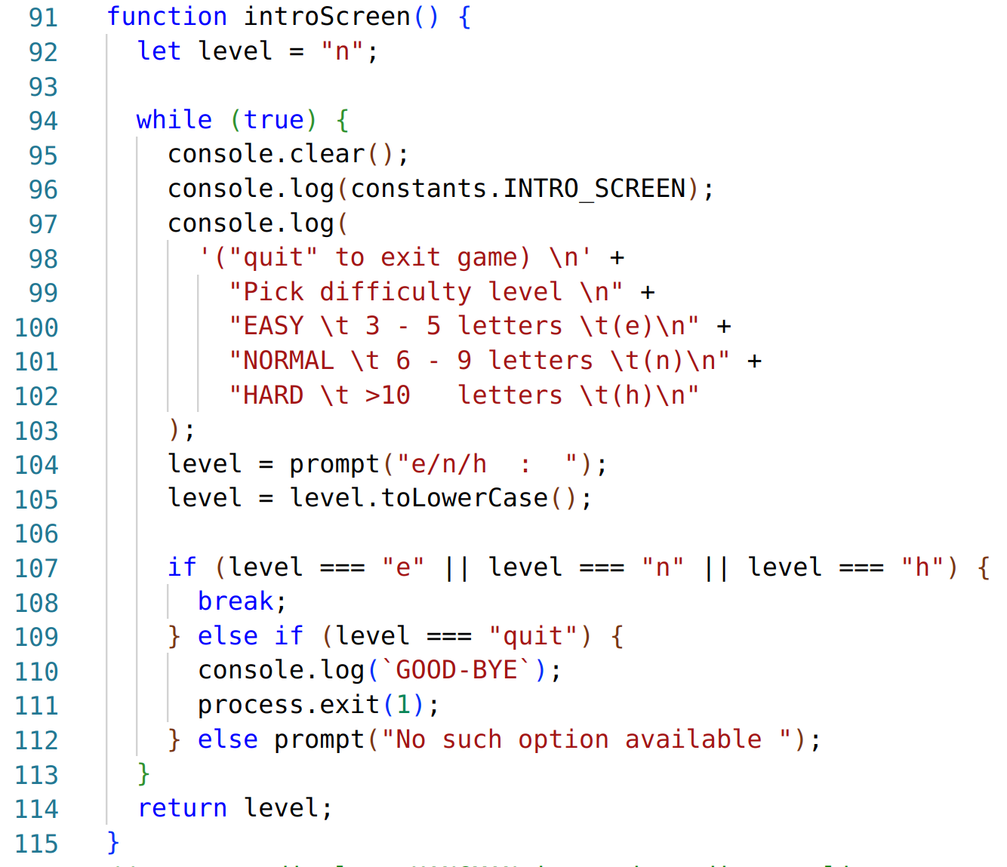
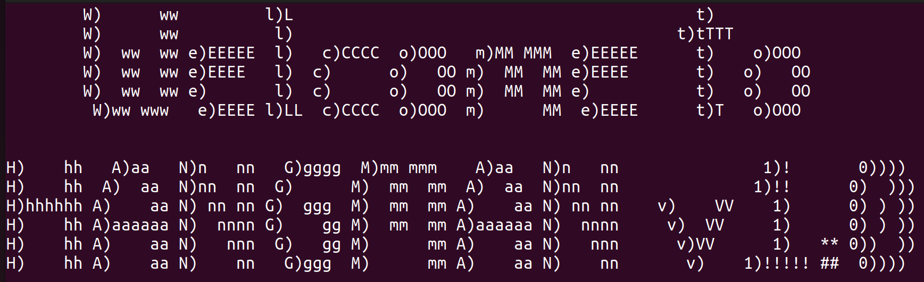
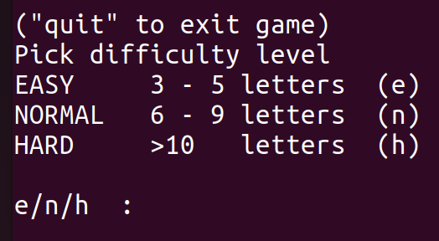
Code snippet
Friday, April 14th 2023
Slide <number>
Zinaida Jusufovic
Martin Egert
Thomas Sicay

Slide 6
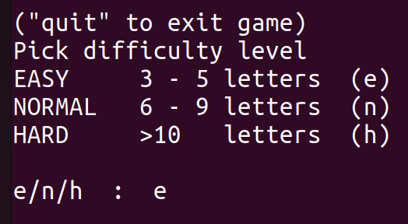
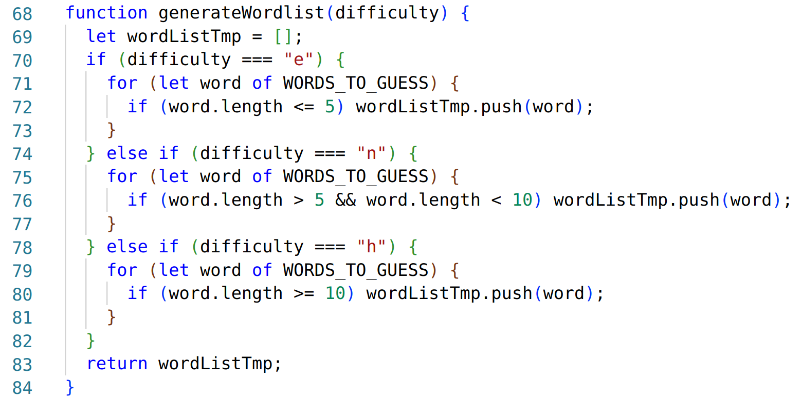
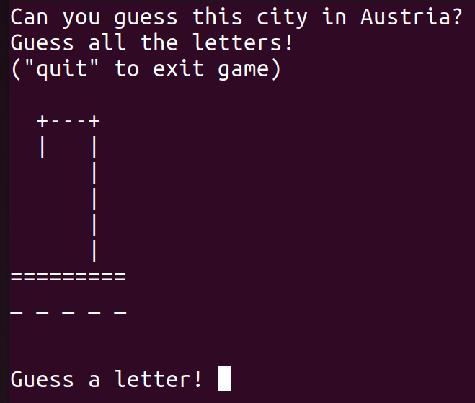
Code snippet
Friday, April 14th 2023
Slide <number>
Zinaida Jusufovic
Martin Egert
Thomas Sicay

